Slide 1
Timebox 1 - Spotify Playlist Generator
BeatBuilders

Slide 2
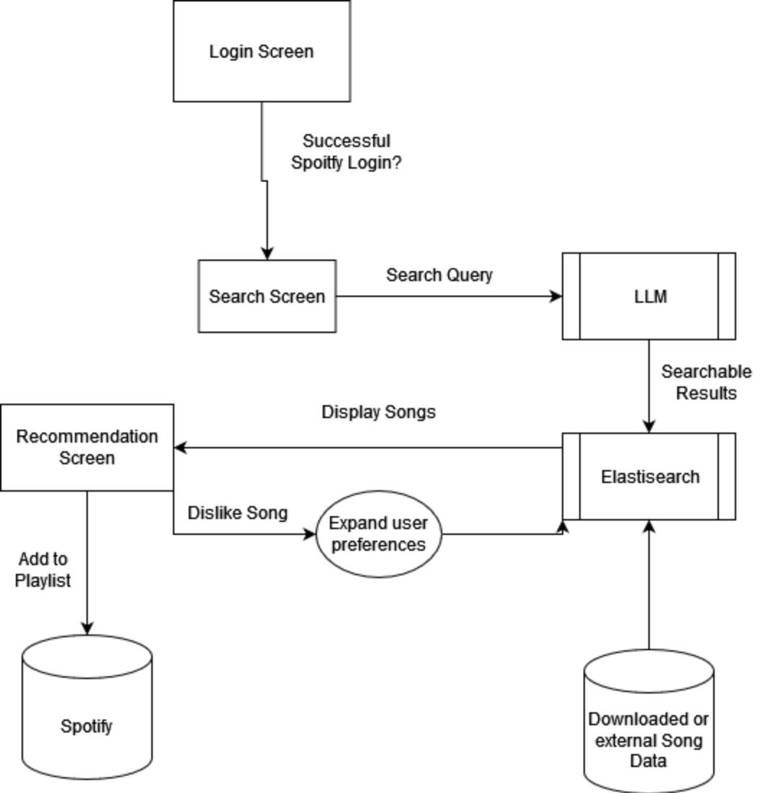
Project - Playlist Generator
Main Idea:
Generate song playlists based on free-form text input
ex) I feel like I’m floating in honey after failing my systems exam
Option to manually go through generated songs to deselect items
Planned language/API:
Website App Development - React and other web development tools
Backend - Python and associated libraries
Database / Authentication - Firebase
Third Party API/Tools - Spotify’s API, Llama-2, LangChain
Notes:
React, Firebase and Python chosen based on prior familiarity
Llama-2 chosen because it is free and open-source

Slide 3
Elasticsearch Plans
Use elasticsearch to create basic playlist generation
Step-by-step Process:
Submit arbitrary/vague input to Llama-2
Receive Llama-2 output as elasticsearch format
Use elasticsearch to document-search spotify for playlist creation
Example:
“Gives me a song that makes me feel like I’m floating in honey”
Llama-2 take user input, uses it’s reasoning capabilities to construct a suitable elasticsearch query
(Song title, artist, and genre)
Elasticsearch generates many songs according to the LLama-2 input

Slide 4
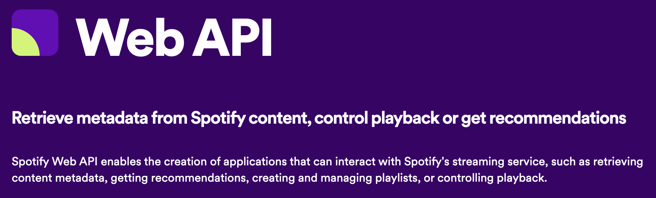
Spotify API - Background
Spotify API is free to use
Tokens expire hourly
Rate limit based on 30s rolling window
User can query by
album
artist
genre
track
year
Etc.
Spotipy

Slide 5
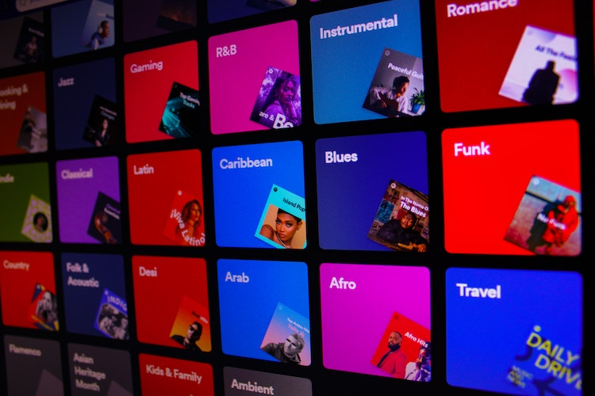
Spotify API - Functionality
Get user data
Playlists, top items, followed artists
Create and edit playlists
Get playlists (by id)
Get information on songs
Acousticness, danceability, energy, valence
Get song recommendations

Slide 6
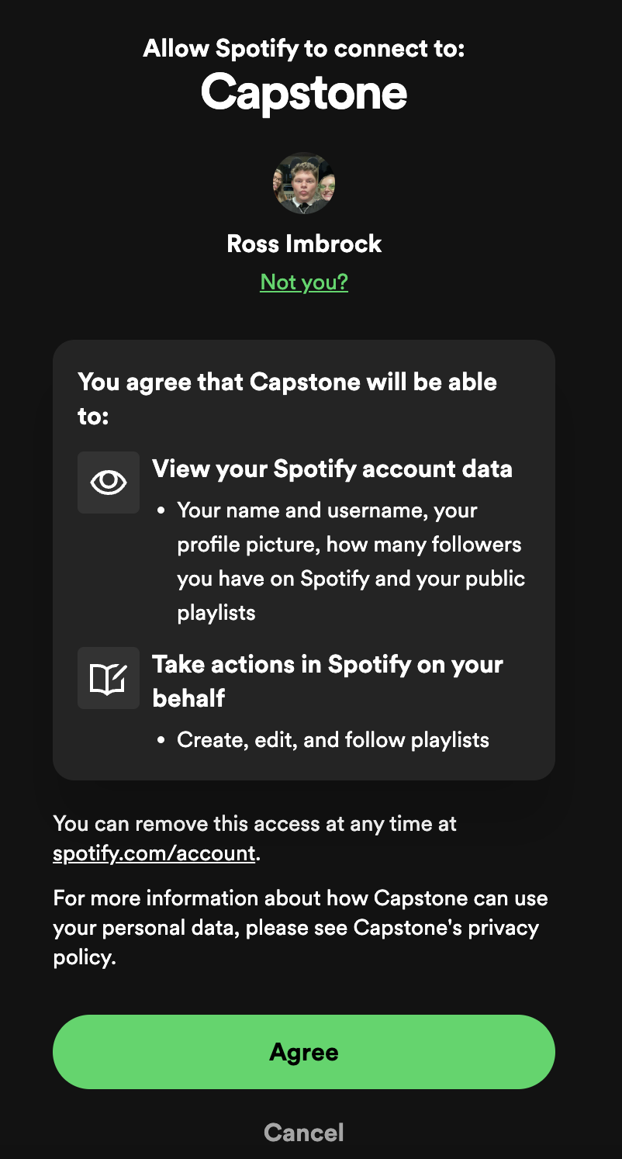
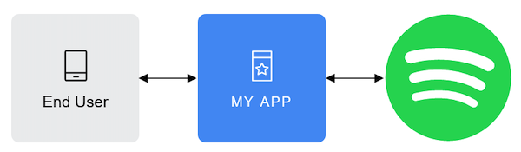
Spotify Authorization and Connection
Final product will be added as playlist to user’s Spotify account
Our application will make a call to the Spotify API to initiate the request for the ability to create a playlist on the user’s account
Uses the OAuth 2.0 framework to authorize users connecting to external applications
https://developer.spotify.com/documentation/web-api/concepts/authorization

Slide 7
LLM Preprocessing
LangChain is a framework for developing applications powered by language models.
It this case it will enable us to utilize LLama-2’s ability to reason based on some provided context
LangChain also allows us to build pipelines which let us wrap extra features around our chosen language model
We are interested in how chains will let us give our LLM some extra context, and prompt-engineering
Notes:
“Hey the user is going to describe a feeling their looking for in a song, or a situation and some songs to listen to to help with it, we need you to take that and transform it into a an elasticserach query for our database”

Slide 8
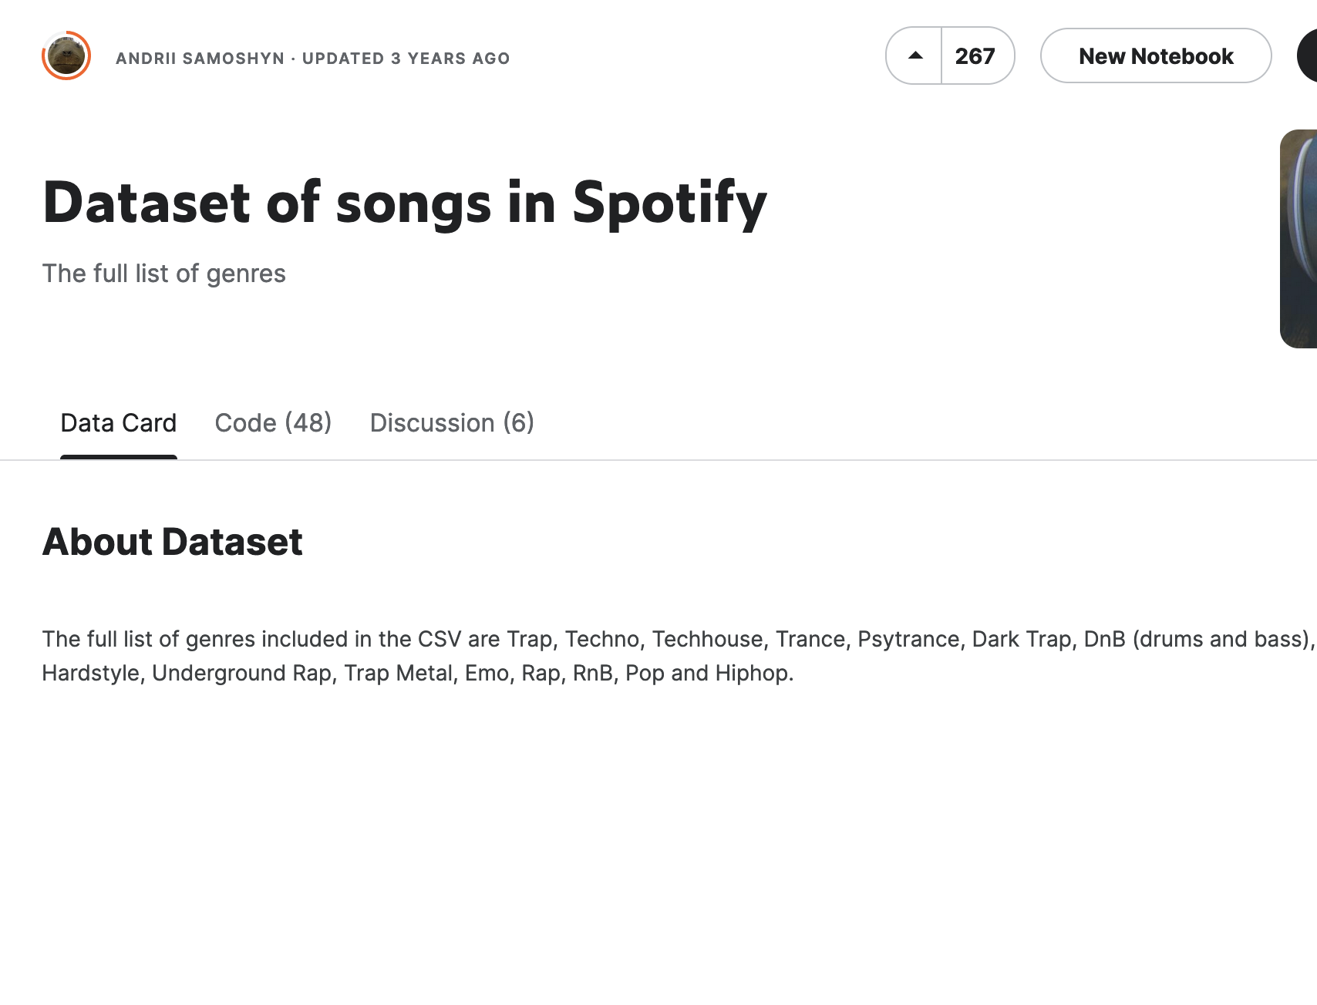
Construction of Song Database
Used for elasticsearch queries
Current ideas for construction:
Utilize current Kaggle datasets
Find other public third-party datasets of songs with suitable data
Combine multiple small available datasets manually
Make 1-shot calls to the spotify API and store the results in the DB for elasticsearch to use
Currently researching strategies to connect database to elasticsearch

Slide 9
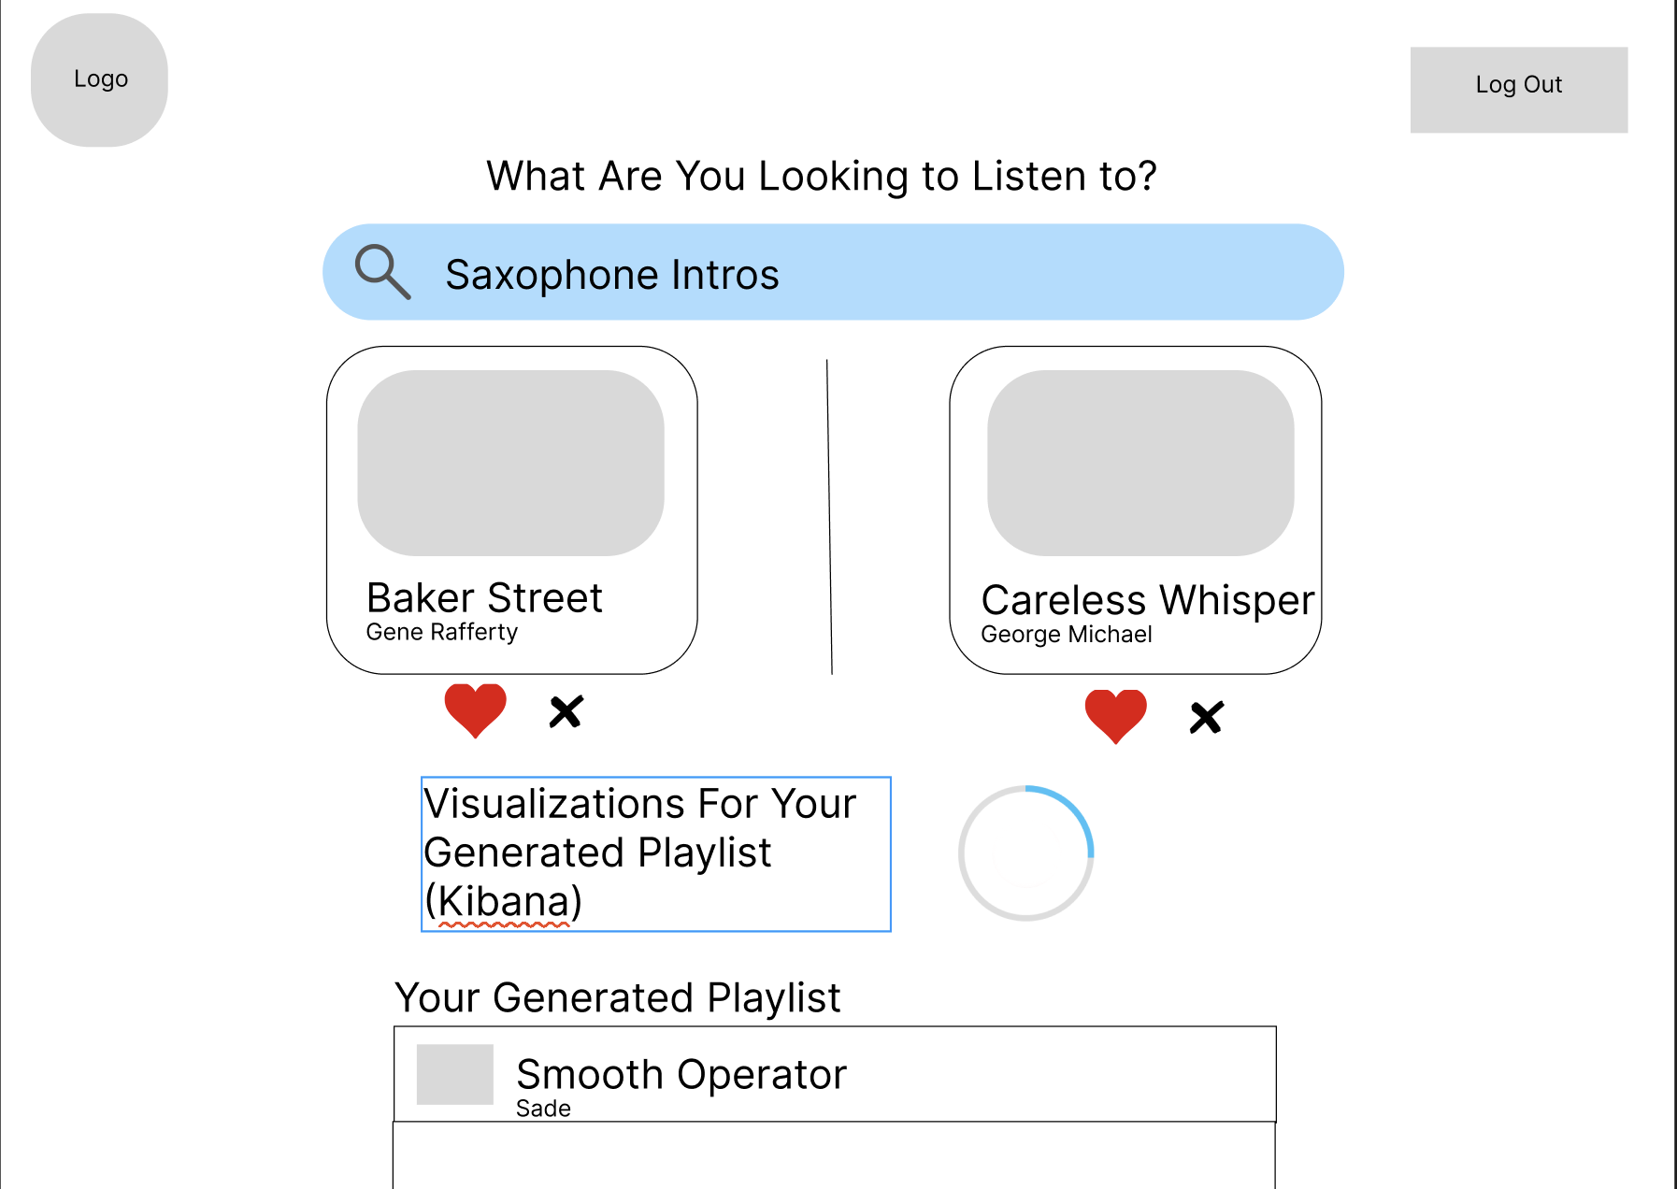
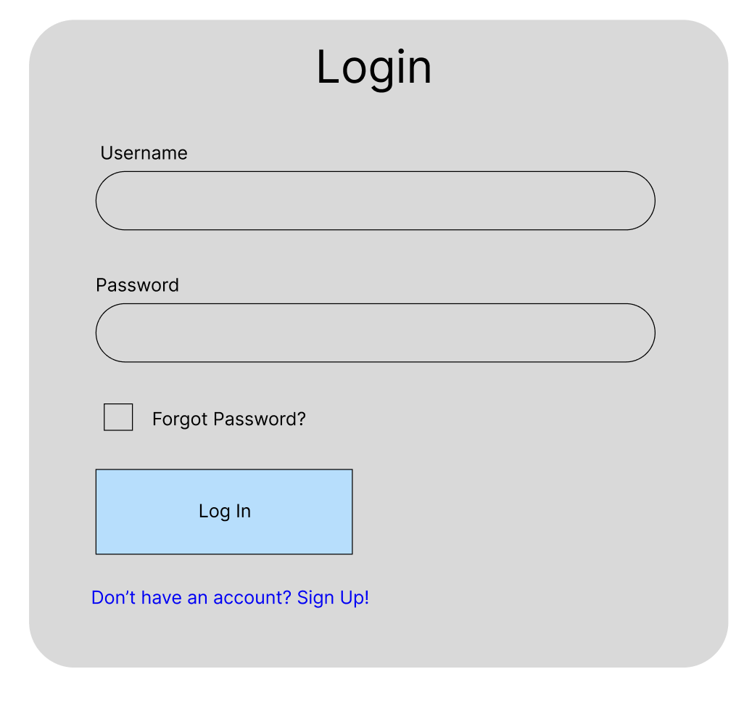
UI Design

Slide 10
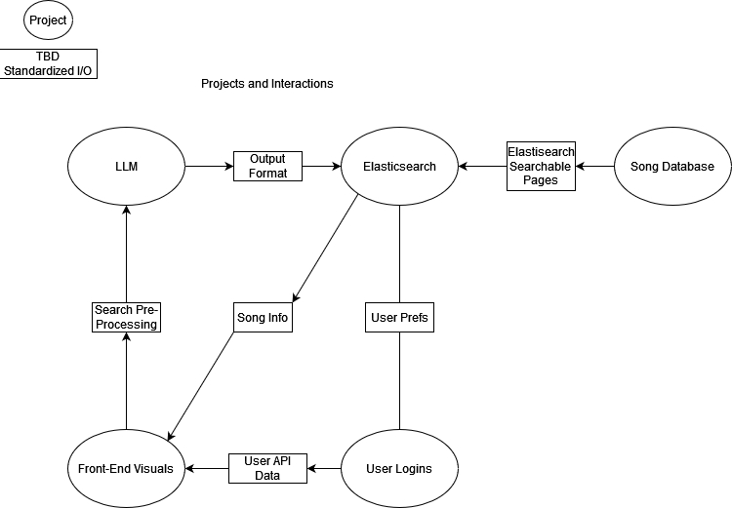
Planned Projects and Interactions Diagram
5 Connected Parts
Front-end UI
User Login/Account information
LLM
Elasticsearch
Song Database
Notes:
Toby

Slide 11
Plan for Next 3 Weeks
Finalize project planning and workload division
Continue researching Llama-2, LangChain, Spotify API, and elasticsearch
Start early development of website with React
Develop a basic model of elasticsearch

